Slide 1
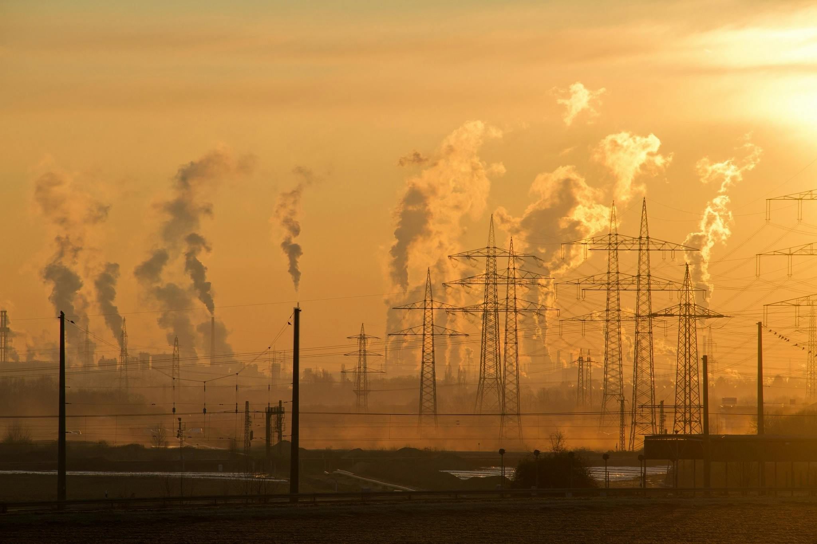
PROJECT
ON
AIR QUALITY PREDICTION
Presented by
C G KISHORE

Slide 2
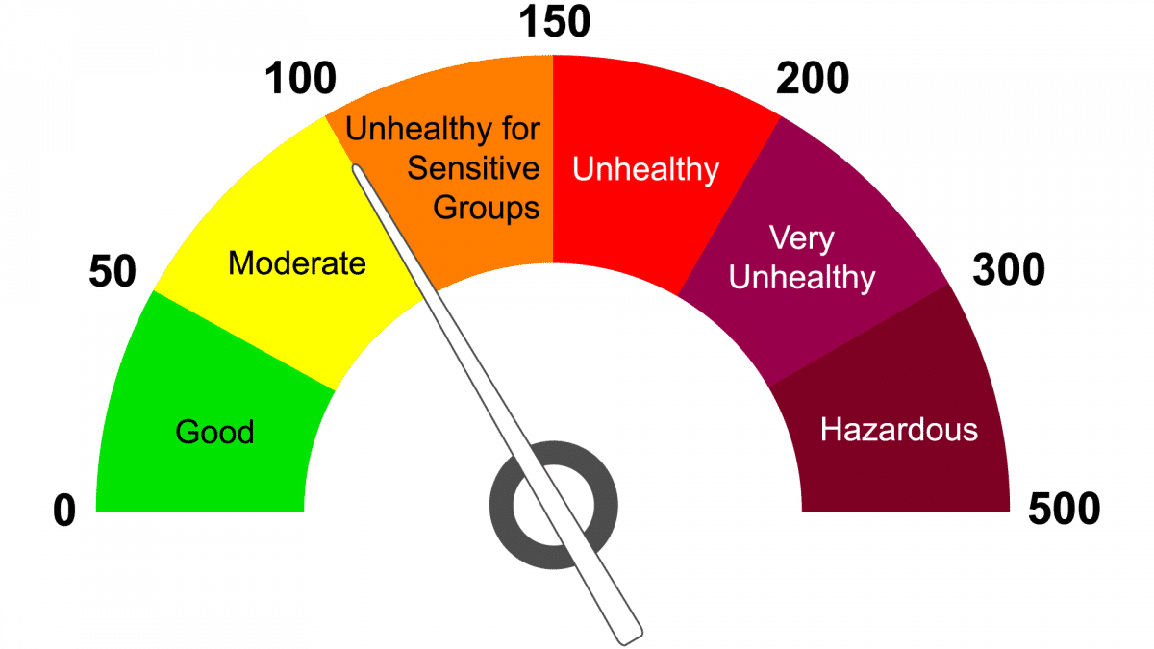
Air Quality Index
Air Quality Index (AQI) is a number used to convey the quality of air by the government to the general public. Air quality deteriorates with an increase in the concentration of pollutants. The Air Quality Index represents the severity of pollution for ordinary people

Slide 3
How to calculate AQI
Step 1:
Identify Key Pollutants: The AQI is typically calculated for the following pollutants:
PM2.5 (Particulate Matter)
PM10 (Particulate Matter)
Ozone (O3)
Nitrogen Dioxide (NO2)
Sulfur Dioxide (SO2)
Carbon Monoxide (CO)
Step2:
Obtain Concentration Values: Collect the concentration data for each pollutant from air quality monitoring stations. These values are usually measured in micrograms per cubic meter (µg/m³) for particulate matter and in parts per billion (ppb) or parts per million (ppm) for gases.

Slide 4

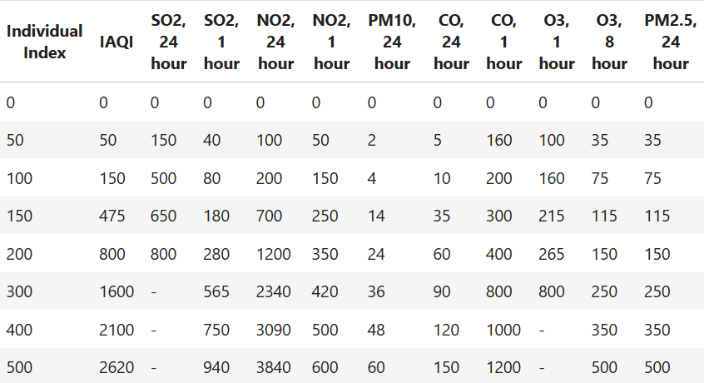
Step 3:
Convert Concentration to AQI: Use standard conversion formulas to calculate the AQI for each pollutant. Each pollutant has its own set of breakpoints that relate the concentration to an AQI value. The following is a common approach:
The AQI formula is given by:
Step 5:
After calculating all the AQI of each pollutant their are various measures to select we can maximum or avg I select avg(mean)

Slide 5
Pollutants
PM2.5:
The concentration of particulate matter (PM) with a diameter of 2.5 micrometers or less, measured in micrograms per cubic meter (µg/m³). PM2.5 can penetrate deep into the lungs and is associated with various health problems.
PM10:
The concentration of particulate matter with a diameter of 10 micrometers or less, measured in micrograms per cubic meter (µg/m³). PM10 includes dust, pollen, and mold spores, which can cause respiratory issues.
SO2:
The concentration of sulfur dioxide in the air, measured in parts per billion (ppb) or micrograms per cubic meter (µg/m³). SO2 is a significant pollutant that can affect air quality and human health.
NO2:
The concentration of nitrogen dioxide in the air, typically measured in parts per billion (ppb) or micrograms per cubic meter (µg/m³). NO2 can cause respiratory problems and is a component of smog.
CO:
The concentration of carbon monoxide in the air, measured in parts per million (ppm) or micrograms per cubic meter (µg/m³). CO is a colorless, odorless gas that can be harmful when inhaled in large amounts.
O3:
The concentration of ozone in the air, typically measured in parts per billion (ppb) or micrograms per cubic meter (µg/m³). Ozone at ground level can cause respiratory issues and is a key component of smog.

Slide 6
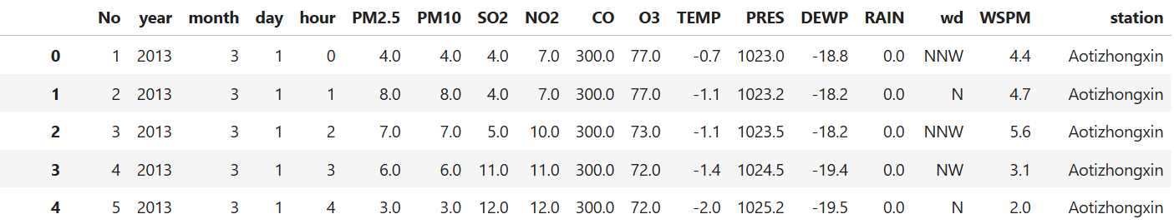
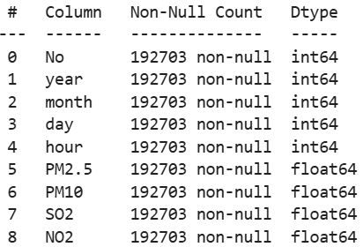
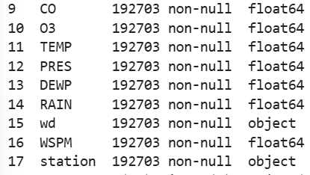
About my Data

Slide 7
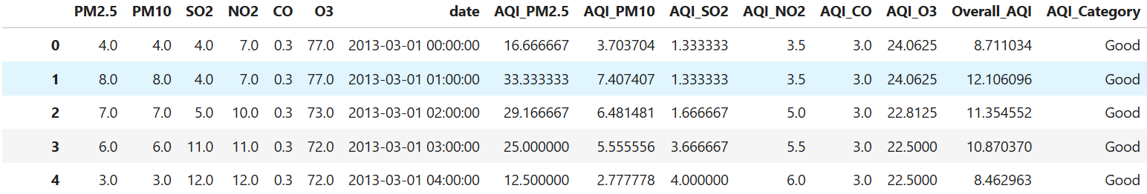
Based on my need I change the original data into the above data
CO is in mg/m3 format
To convert it to mug/m3 divided the CO by 1000
After that keeping the pollutants which are necessary and deleting all the columns
By the above AQI formula and each pollutant concentration calculating the AQI for each pollutant
After calculating the AQI for each pollutant taking average of all to find Overall AQI
Based on the AQI scale categorize the Overall AQI to different AQI Category

Slide 8
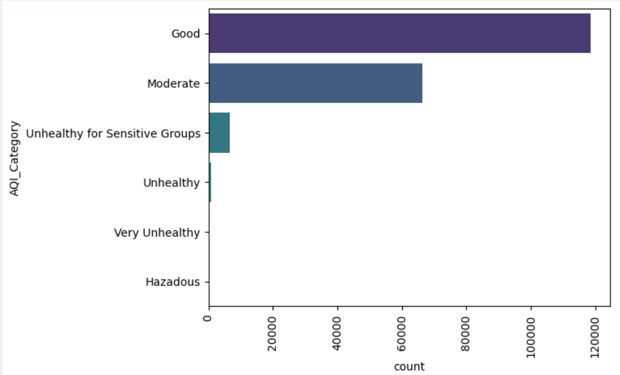
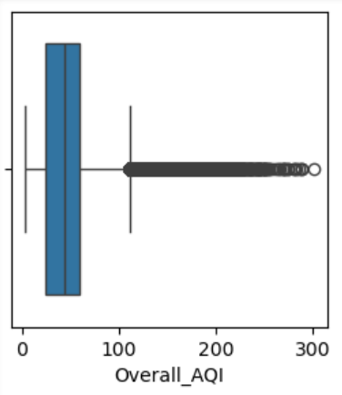
Different Categories and Overall AQI

Slide 9
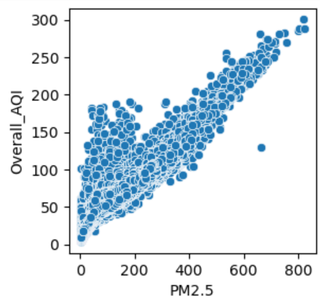
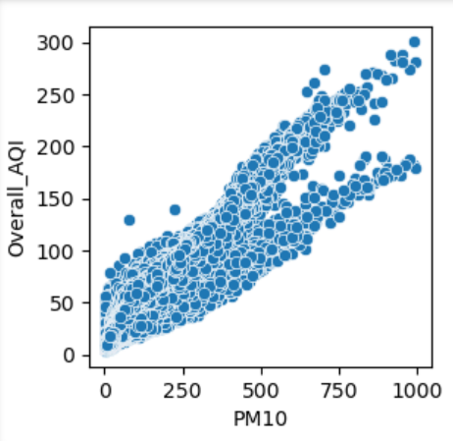
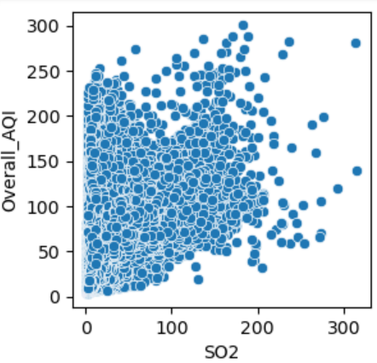
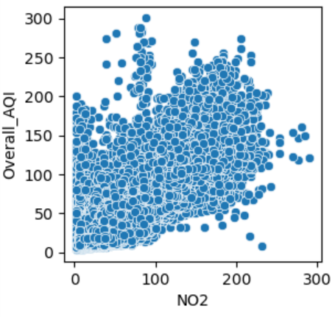
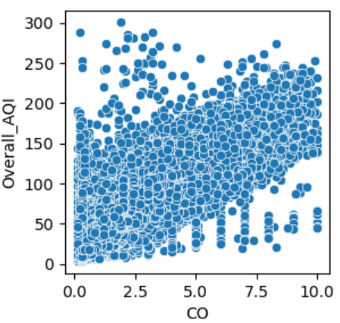
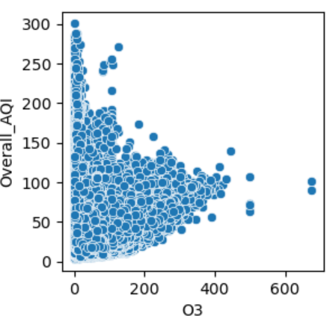
Various Pollutants vs Overall AQI

Slide 10
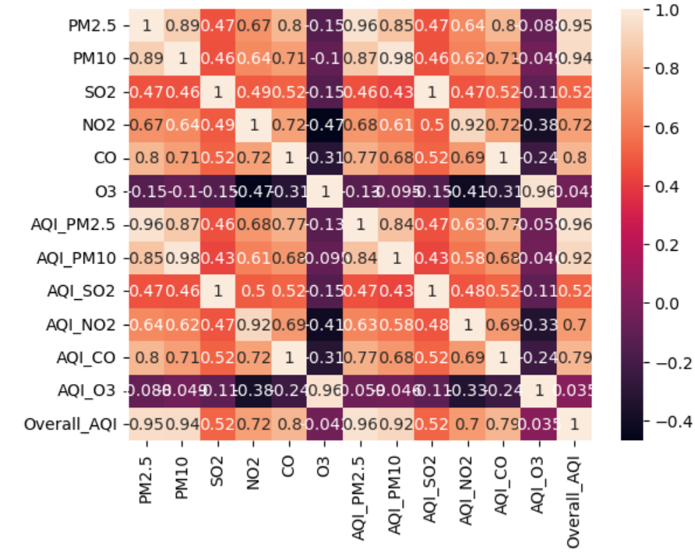
Co-relation among all pollutants and AQI
By the beside correlation plot of each pollutant and AQI of each pollutant and overall AQI mostly all the pollutants had strong relationship with overall AQI.

Slide 11
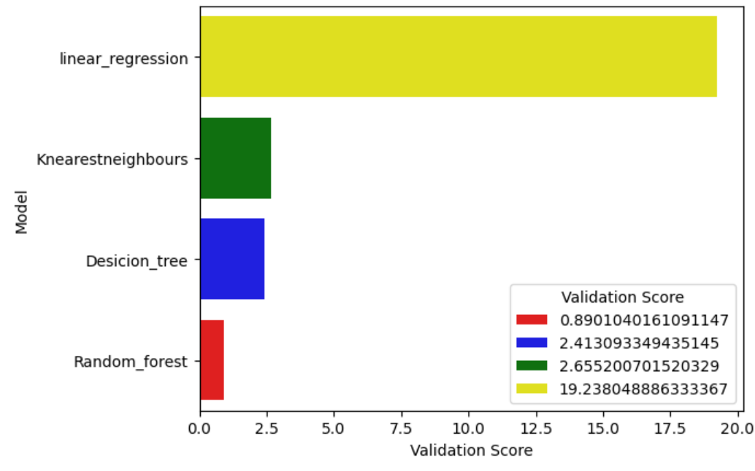
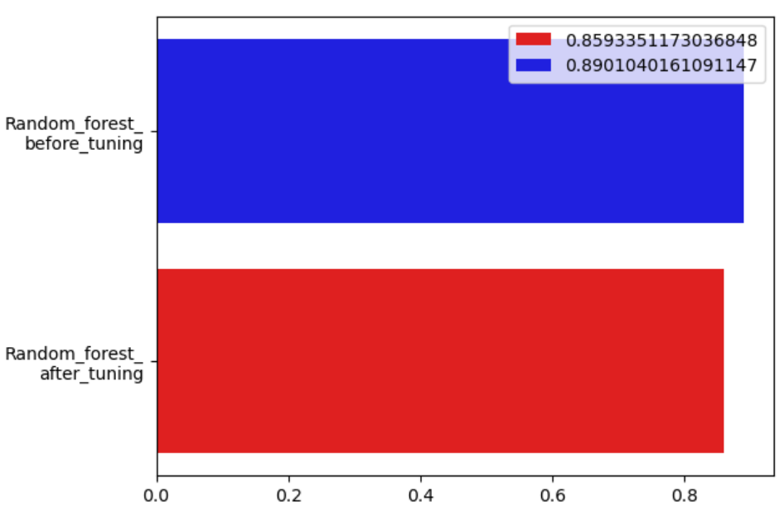
Validation Score of Different Models

Slide 12
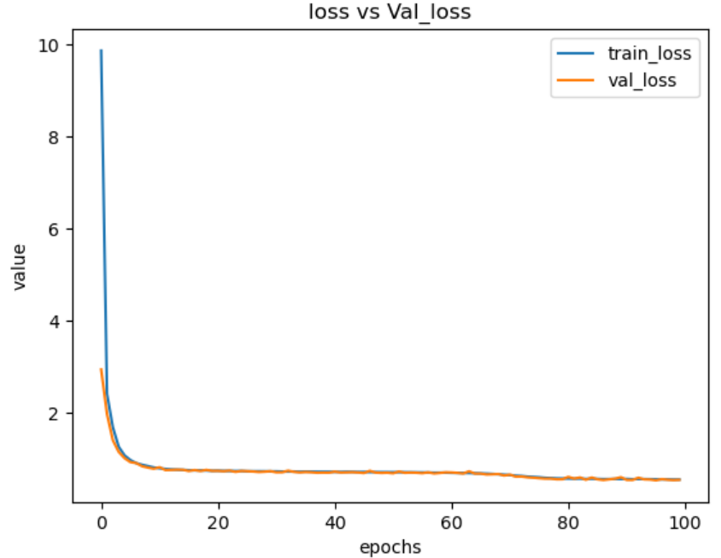
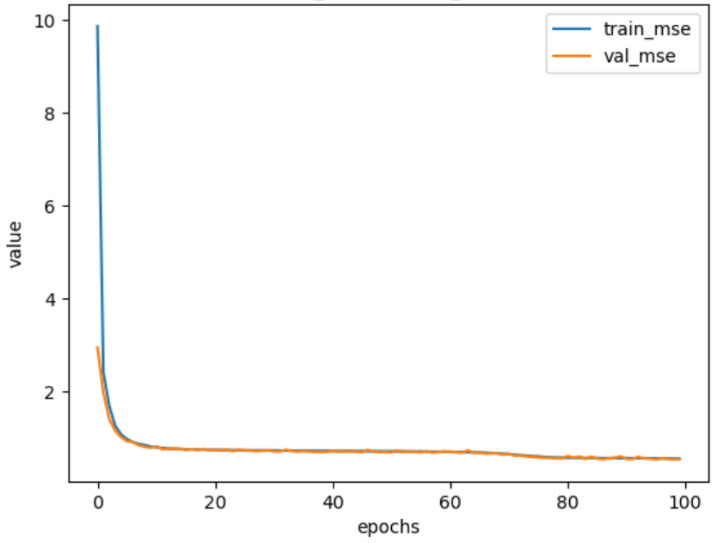
Loss and Error for train and validation of each epoch

Slide 13
Conclusion
Based on the data of various pollutants I train a model that predict the AIR Quality
I trained over different models like linear regression, Decision tree, Random forest and ANN (MLP)
Among all the models ANN(MLP) performs very well with low error i.e, nearly 0.7
I saved that model using tensorflow.keras
I deploy the model using the streamlit.

Slide 14


